Slide 1

ChatBot
Department of Computer Engineering
GUIDED BY:-
Prof. Samir Kariya
PRESENTED BY:
Darshan Jabuani - 91900103130
Tejas Faldu - 91900103109
Drashti Borad - 91900103105

Slide 2
Content
Introduction
Purpose of ChatBot
Functional Requirements
Non-Functional Requirements
Diagrams
Advantages of ChatBot
Disadvantages of ChatBot
Technology
Reference

Slide 3
Introduction
Chatbot, also known as conversational agents, are designed with the help of AI software. They simulate a conversation (or a chat) with users in a natural language via messaging applications, websites, mobile apps, or phone.
Chatbot is very important feature of a web which communicates with the user visiting the site.
Chat bots typically provide text based user interface, allowing the user to type commands and receive text.
Chat bot are usually stateful service, remembering previous commands in order to provide functionality when chat bot technology is integrated with popular web services it can be utilize securely by an even larger audience.

Slide 4
Purpose of ChatBot
It’s main purpose is to communicate with the user and answer their queries.
It is designed mainly for college purpose like finding the location of faculty.
It makes easy for the user like faculty or student to know the location of the other faculties at the moment.

Slide 5
Functional Requirements
API Calls
Great UI
Well trained with the FAQ’s
Data security

Slide 6
Non-Functional Requirements
Fast response
Security
Easy to use
Accuracy

Slide 7
Diagrams

Slide 8
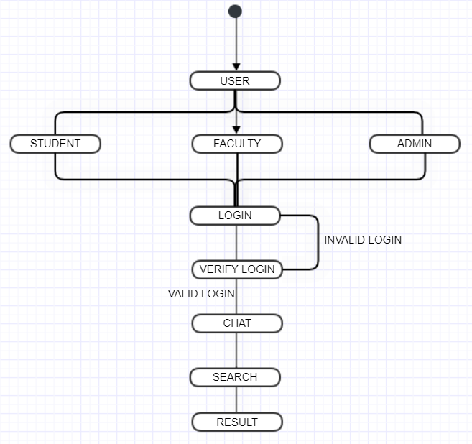
Activity Diagram

Slide 9
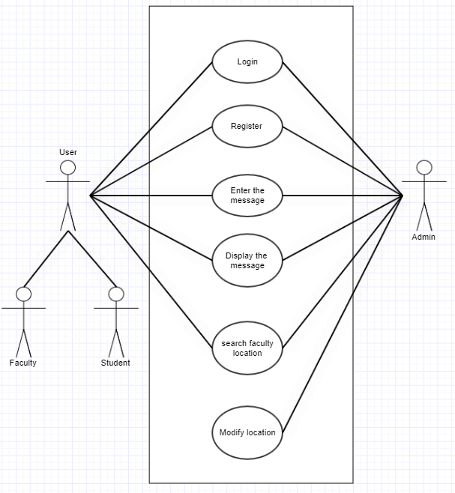
Use Case Diagram

Slide 10
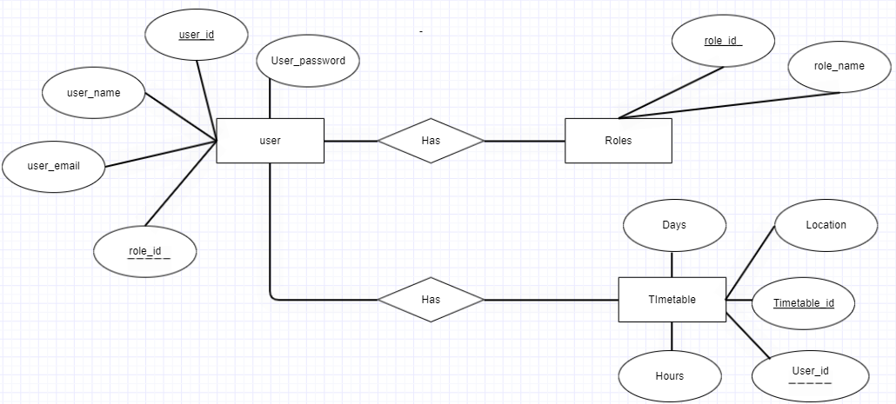
E-R Diagram

Slide 11
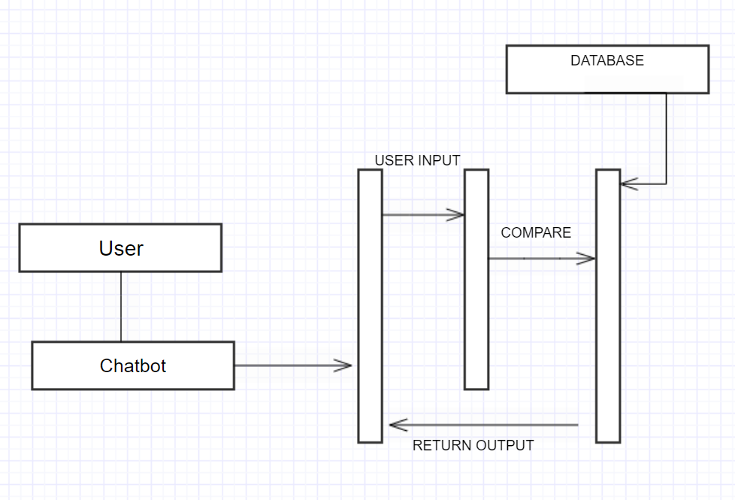
Sequence Diagram

Slide 12
Advantages of ChatBot
User does not have to go personally to college for the queries.
This application enables the user to be updated with the college activites.
This application saves time for teaching staff.

Slide 13
Disadvantages of ChatBot
Lack emotion
Difficult to create
Require maintain
Requires active internet connection as error may occur.

Slide 14
Technology
React.js
Node.js
Dialogflow
Mysql

Slide 15
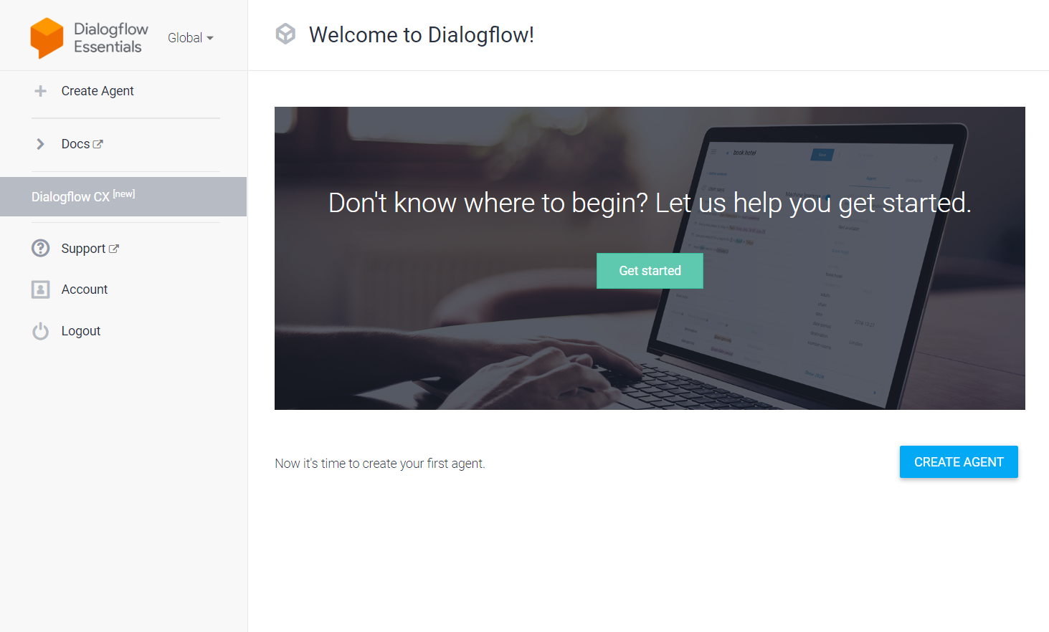
Dialogflow

Slide 16
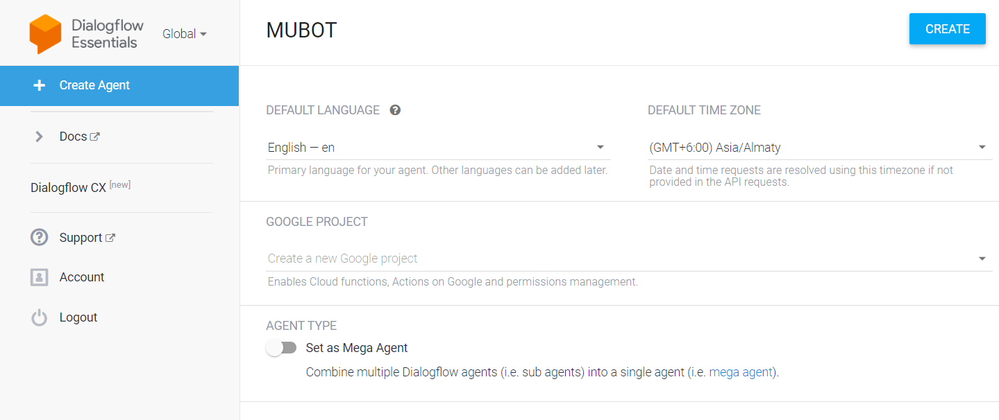

Slide 17
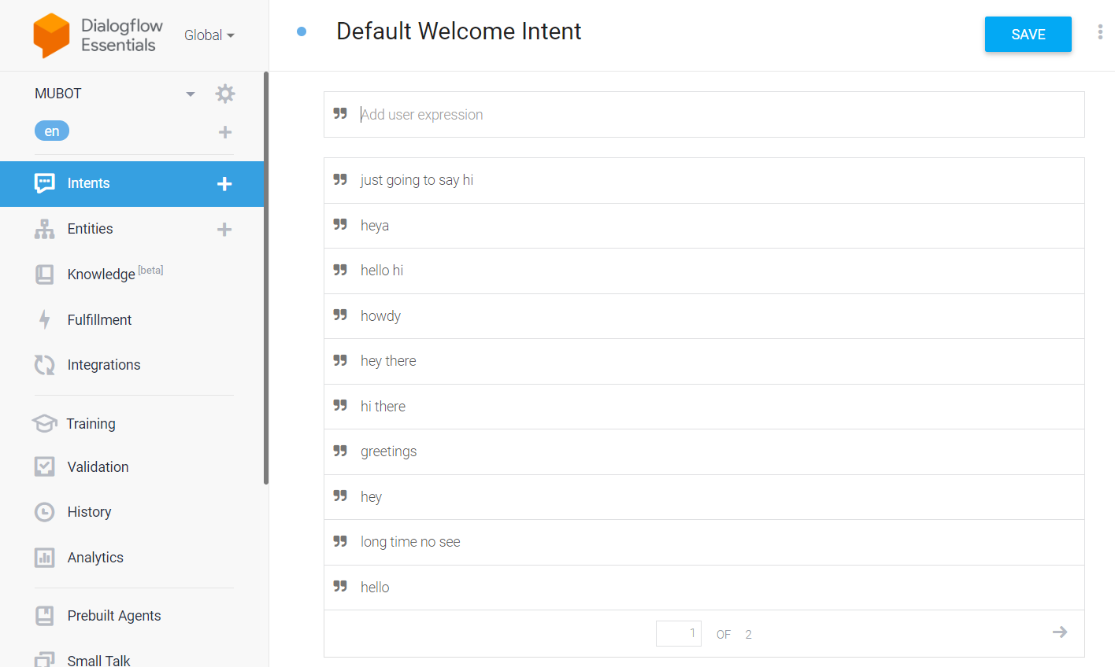

Slide 18
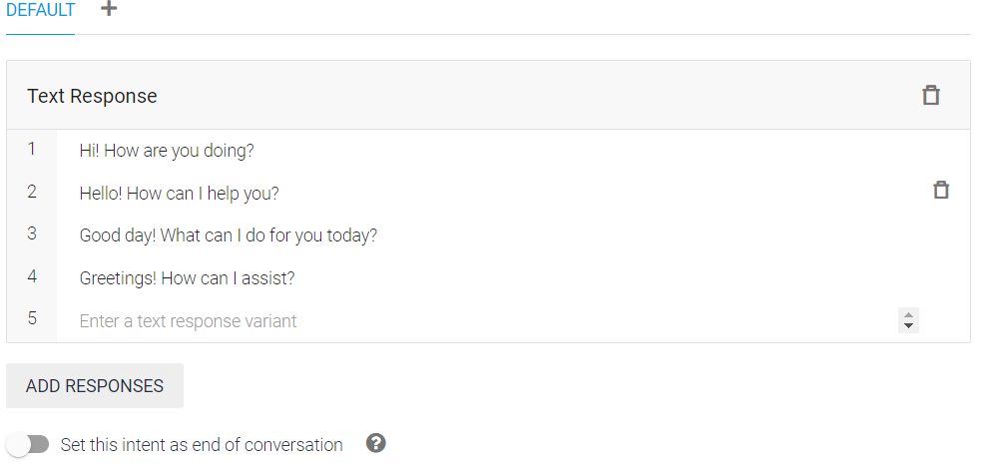

Slide 19
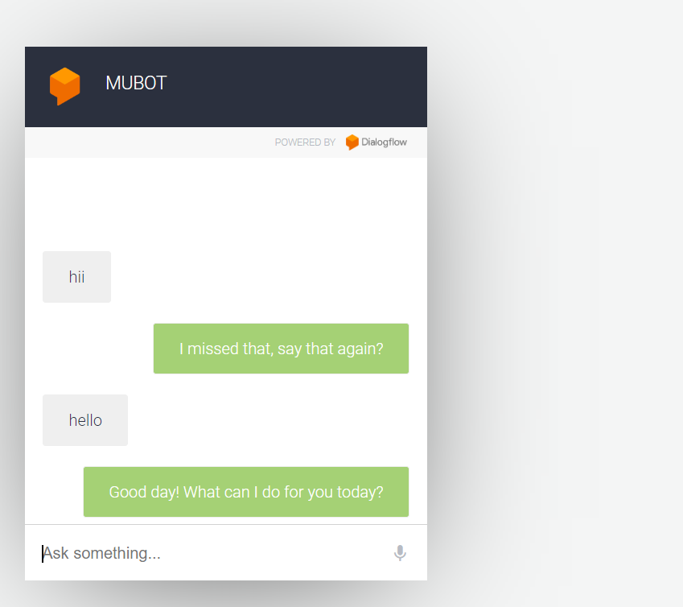

Slide 20
Reference
https://cloud.google.com/dialogflow/es/docs
https://reactjs.org/docs/getting-started.html
https://www.w3schools.com/

Slide 21
THANK YOU

